Slide 1
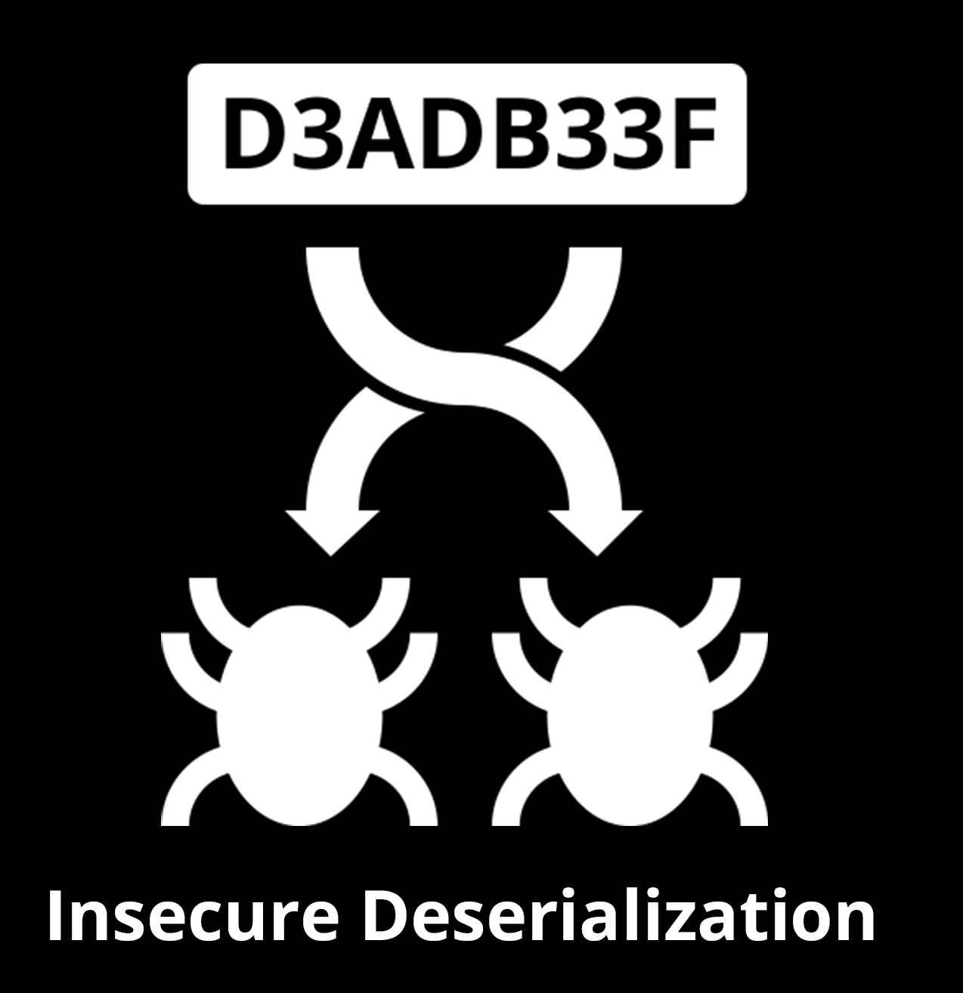
Insecure Deserialization
Pierre Ernst, OWASP Ottawa
pierre.ernst@owasp.org
https://twitter.com/e_rnst
https://linkedin.com/in/pernst

Slide 2

Notes:
Image Source: https://commons.wikimedia.org/wiki/File:Thank-you-word-cloud.jpg

Slide 3
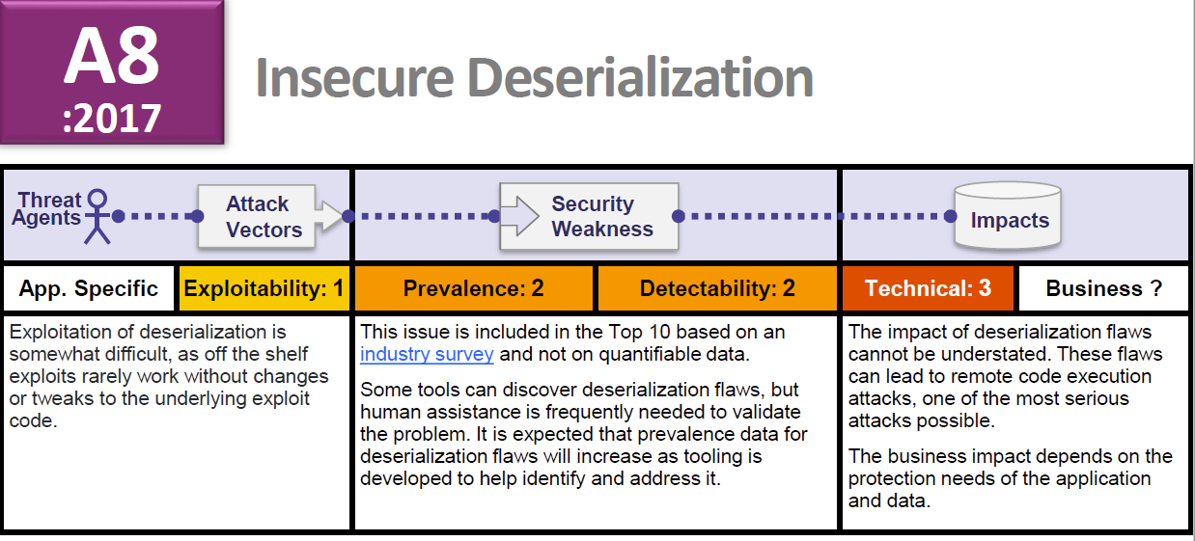
Added in 2017

Slide 4
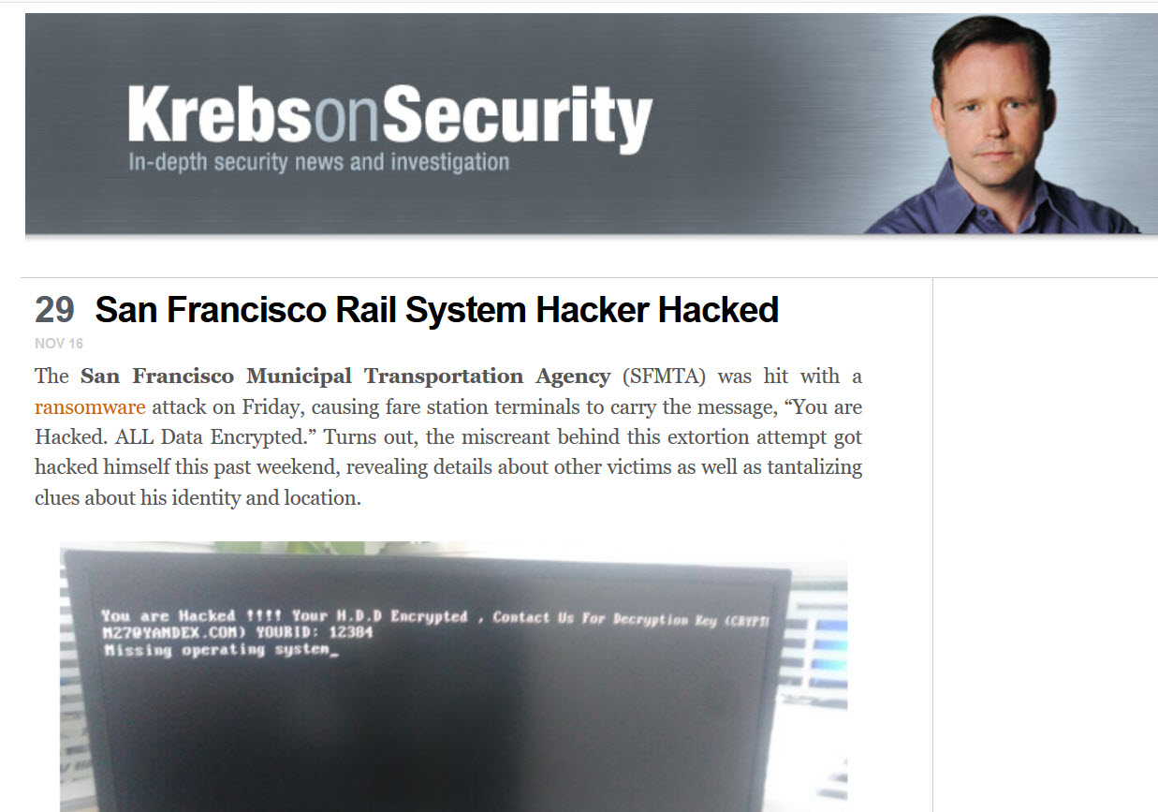
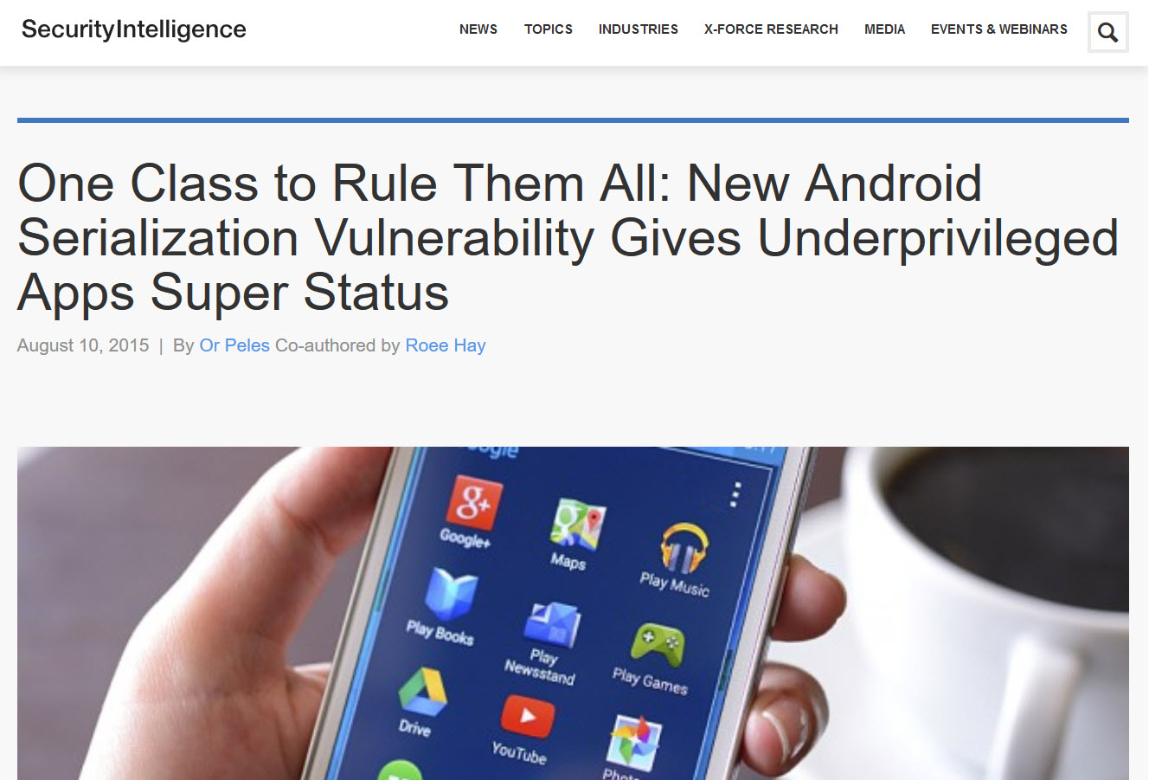
Notes:
https://securityintelligence.com/one-class-to-rule-them-all-new-android-serialization-vulnerability-gives-underprivileged-apps-super-status/
https://krebsonsecurity.com/2016/11/san-francisco-rail-system-hacker-hacked/

Slide 5
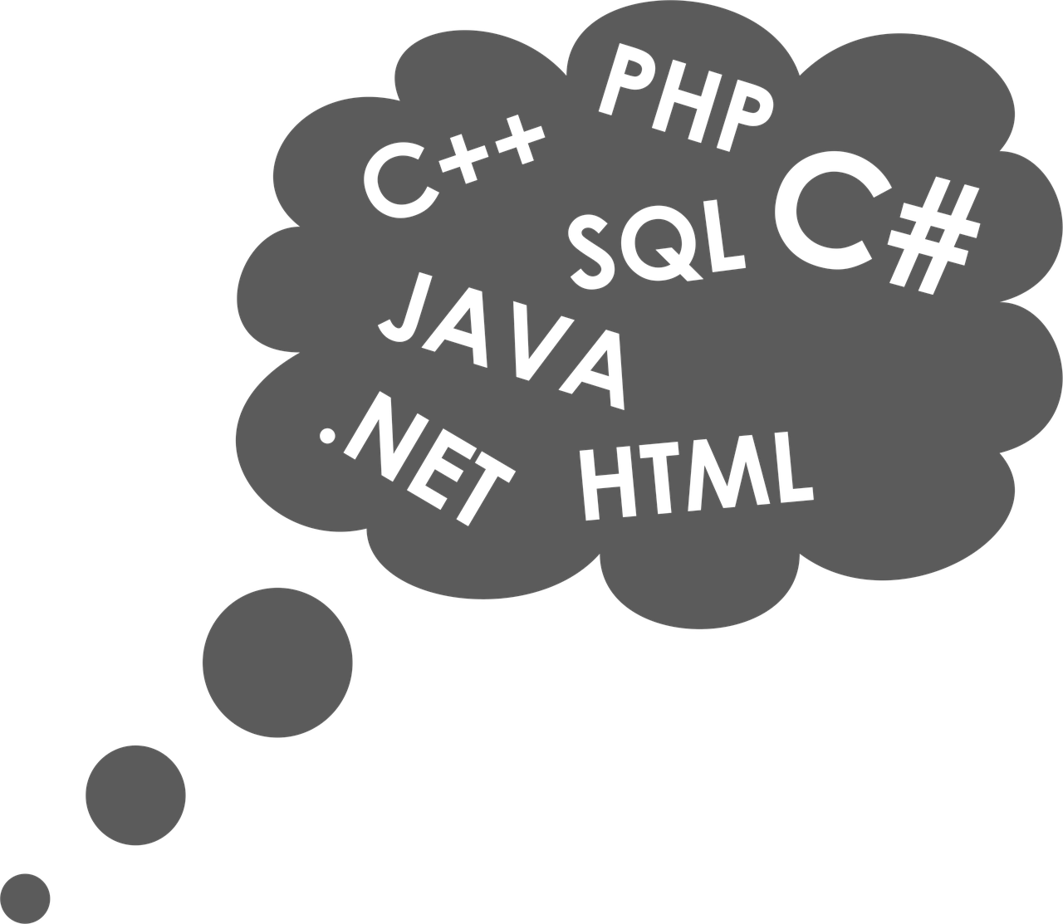
Applies to
Java
.Net
PHP
Python
Notes:
Image Source: https://pixabay.com/en/cloud-programmer-1835333/

Slide 6
Our example
<<interface>> Serializable
BicycleBean
Name: String NumberOfWheels: int NumberOfRiders: int

Slide 7

Java Serialization 101
serialize
deserialize
00000000 AC ED 00 05 73 72 00 2A 6F 72 67 2E 6F 77 61 73 ....sr.*org.owas
00000010 70 2E 6F 74 74 61 77 61 2E 74 6F 70 74 65 6E 32 p.ottawa.topten2
00000020 30 31 37 5F 41 38 2E 42 69 63 79 63 6C 65 42 65 017_A8.BicycleBe
00000030 61 6E BE 8E 31 4B D9 05 96 67 02 00 03 49 00 0E an..1K...g...I..
00000040 6E 75 6D 62 65 72 4F 66 52 69 64 65 72 73 49 00 numberOfRidersI.
00000050 0E 6E 75 6D 62 65 72 4F 66 57 68 65 65 6C 73 4C .numberOfWheelsL
00000060 00 04 6E 61 6D 65 74 00 12 4C 6A 61 76 61 2F 6C ..namet..Ljava/l
00000070 61 6E 67 2F 53 74 72 69 6E 67 3B 78 70 00 00 00 ang/String;xp...
00000080 01 00 00 00 02 74 00 08 46 61 74 20 42 69 6B 65 .....t..Fat Bike
Notes:
Imagine we have a BicycleBean instance
AC ED 00 05: Remember this
Image Source: https://pixabay.com/en/mtb-bike-mountain-bike-bike-bicycle-162107/

Slide 8
Java Serialization 101
Convert Java instance to/from a binary stream
Used for persistence (file, database blob)
Used for transmission (RMI: Remote Method Invocation)
Java API:
ObjectOutputStream: to serialize (write)
ObjectInputStream: to deserialize (read)
JVM knows how to (de)serialize primitive types
JVM uses reflection and Unsafe to (de)serialize members of any given class.
Must implements interface java.io.Serializable

Slide 9
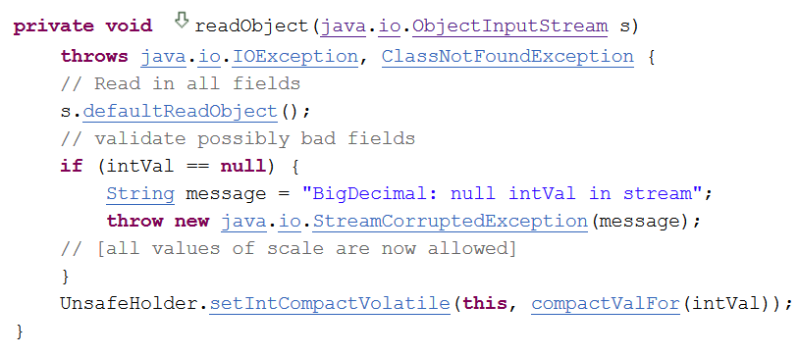
Java Serialization 101
Some classes require special handling
writeObject() and readObject() methods
e.g.: java.math.BigDecimal

Slide 10
Key Takeaway
If a class declares a readObject() method, it will be automatically called when deserializing an instance of that class.

Slide 11
What could possibly go wrong?
An application is vulnerable if:
deserializing untrusted input,
and existing classes on the classpath have “unsecure” readObject() method
The readObject() methods can be chained, abused
“gadget” in reference to ROP gadgets
Similarly, some other methods can also be abused
“Magic Methods”
Notes:
Root cause is *NOT* weak boundary between data & code
Magic methods not always present

Slide 12

Magic Methods
readObject()
readResolve()
validateObject()
readObjectNoData()
readExternal()
finalize()
<init>()
Notes:
Image Source: http://www.publicdomainfiles.com/show_file.php?id=13939492812397

Slide 13

How can magic methods be abused?
Any side effect with security impact:
File I/O
Network I/O
Code injection
Denial of service
…
Notes:
Usually something that has a static impact
Image Source: http://maxpixel.freegreatpicture.com/Pirate-Computer-Virus-Hacker-Security-Password-1468169

Slide 14
Gadget Example (with Magic Method)
package org.owasp.ottawa.topten2017_A8;
public class UnusedBeanWithSideEffect implements Serializable {
private String cmd = null;
private void readObject(ObjectInputStream in) throws Exception {
// this will deserialize 'cmd'
in.defaultReadObject();
Runtime.getRuntime().exec(this.cmd);
}
}
Notes:
The simple fact of declaring this private method is enough to trigger a side effect: it will be called during deserialization.

Slide 15
Anatomy of an Attack
Attacker
Vulnerable Service
JVM
Malicious serialized input (UnusedBeanWithSideEffect.class)
Deserialization (BicycleBean.class)
UnusedBeanWithSideEffect
BicycleBean instance = (BicycleBean)in.readObject();
classpath
Calls “magic” method
private void readObject
(ObjectInputStream in){
}
Notes:
Successful exploitation requires both attack surfaces
CastException will be thrown after the magic method has executed

Slide 16
Prior Art (pre-2016)
Date | Type | Product | Researcher(s) | Reference
Apr 2005 | DOS | JRE | Marc Schönefeld | CVE-2004-2540
Aug 2008 | RCE | JRE | Sami Koivu | CVE-2008-5353
Apr 2010 | RCE | JRE | Sami Koivu | CVE-2010-0094
Mar 2010 | DOS | Sun Java Web Console | Luca Carettoni | Source Code
Sept 2011 | RCE | Spring Framework | Wouter Coekaerts | CVE-2011-2894
Oct 2012 | RCE | IBM Cognos BI | Pierre Ernst | CVE-2012-4858
Feb 2013 | RCE | Apache OpenJPA | Pierre Ernst | CVE-2013-1768
Mar 2013 | RCE | Apache Tomcat | Pierre Ernst | CVE-2013-2185
July 2015 | RCE | Apache Groovy | "cpnrodzc7" | CVE-2015-3253
Aug 2015 | RCE | Android | Or Peles & Roee Hay | CVE-2015-3837
Nov 2015 | RCE | Apache Commons Collections | C. Frohoff & G. Lawrence | CVE-2015-7450
Nov 2015 | DOS | JRE | Wouter Coekaerts | Source Code
Notes:
RCE: Remote Code Execution
DOS: Denial of Service

Slide 17

demo
Notes:
Image Source: https://pixabay.com/en/joint-dolls-runners-jog-marathon-3143515/

Slide 18

Mitigation
Notes:
Image Source: https://pixabay.com/en/shield-escutcheon-heater-shield-31869/

Slide 19
Mitigation Idea #1: Wait for Oracle to fix the “horrible mistake”
“Serialization was a horrible mistake made in 1997”
Mark Reinhold, Chief Architect Java Platform Group Oracle
Small step in the right direction
JPMS == Attack Surface Reduction
Java 9 Platform Module System
“This is only a good strategy if Oracle also has a time machine”
Patrick Gray, Risky Business podcast #501

Slide 20
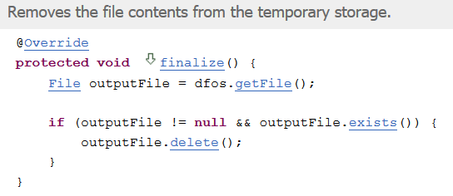
Mitigation Idea #2: Sandboxing
Deserialization inside a block protected by a Security Manager
Could prevent “malicious” calls
File R/W access
Process creation
Network access
…
Not recommended:
Hard to fine-tune:
what is legitimately required?
Known to be broken
e.g. CVE-2013-4444 code inside finalize() can be abused
Notes:
Strongly encourage to stop using deserialization altogether

Slide 21
Mitigation Idea #3: Class Name Input Validation
We want to validate which classes get deserialized
Look-ahead Java deserialization, Jan 2013, Pierre Ernst
Concept used by various validation libraries
SerialKiller, by Luca Carettoni
contrast-rO0 by Contrast Security
CERT Secure Coding SER12-J
JDK enhancement proposal #290

Slide 22
As usual, 2 ways of validating input
Allow-list
Only allow the input if it belongs to a defined list of known good values
Block-list
Reject the input if it belongs to a defined list of known bad values

Slide 23
Object Serialization Stream Protocol
Defines a “class description”
Link to Specs
TC_CLASSDESC
className
STREAM_VERSION
STREAM_MAGIC
TC_OBJECT
00000000 AC ED 00 05 73 72 00 2A 6F 72 67 2E 6F 77 61 73 ....sr.*org.owas
00000010 70 2E 6F 74 74 61 77 61 2E 74 6F 70 74 65 6E 32 p.ottawa.topten2
00000020 30 31 37 5F 41 38 2E 42 69 63 79 63 6C 65 42 65 017_A8.BicycleBe
00000030 61 6E BE 8E 31 4B D9 05 96 67 02 00 03 49 00 0E an..1K...g...I..
00000040 6E 75 6D 62 65 72 4F 66 52 69 64 65 72 73 49 00 numberOfRidersI.
00000050 0E 6E 75 6D 62 65 72 4F 66 57 68 65 65 6C 73 4C .numberOfWheelsL
00000060 00 04 6E 61 6D 65 74 00 12 4C 6A 61 76 61 2F 6C ..namet..Ljava/l
00000070 61 6E 67 2F 53 74 72 69 6E 67 3B 78 70 00 00 00 ang/String;xp...
00000080 01 00 00 00 02 74 00 08 46 61 74 20 42 69 6B 65 .....t..Fat Bike
Notes:
Len(“org.owasp.ottawa1.topten2017_A8.BicycleBean”) = 42 = (2A)₁₆

Slide 24
Look-ahead Java deserialization
So we could use our own binary parser to decide whether we should stop reading the stream…
… or use existing Java API that allows us to add our own validation hook.
Callback provided by Java
Normally used for custom class loading

Slide 25
Allow-List
public class LookAheadObjectInputStream extends ObjectInputStream {
@Override
protected Class<?> resolveClass(ObjectStreamClass desc) {
if ( ! desc.getName().equals(
"org.owasp.ottawa.topten2017_A8.BicycleBean") ) {
throw new InvalidClassException(
"Unauthorized deserialization attempt",
desc.getName());
}
return super.resolveClass(desc);
}
}

Slide 26
Block-List
public class LookAheadObjectInputStream extends ObjectInputStream {
@Override
protected Class<?> resolveClass(ObjectStreamClass desc) {
if ( desc.getName().equals(
"org.owasp.ottawa.topten2017_A8.UnusedBeanWithSideEffect") ) {
throw new InvalidClassException(
"Unauthorized deserialization attempt",
desc.getName());
}
return super.resolveClass(desc);
}
}

Slide 27
JEP 290 (JDK Enhancement Proposal)
Relies on the Look Ahead concept
Validation filters can be configured:
Process-wide
(and/or) Per individual ObjectInputStream instance
Validation: Class name, plus other metrics to prevent DOS
Filter Status:
Allowed
Rejected
Undecided
Implemented in:
Java 9
Java 8 (≥8u121)
Java 7 (≥7u131)

Slide 28
Process-Wide Block-List (JEP 290)
System.setProperty("jdk.serialFilter",
"!org.owasp.ottawa.topten2017_A8.UnusedBeanWithSideEffect");
ObjectInputStream ois = new ObjectInputStream( /* … */ );
ois.readObject();
sun.misc.ObjectInputFilter$Config lambda$static$0
INFO: Creating serialization filter from
!org.owasp.ottawa.topten2017_A8.UnusedBeanWithSideEffect
java.io.ObjectInputStream filterCheck
INFO: ObjectInputFilter REJECTED: class org.owasp.ottawa.topten2017_A8.UnusedBeanWithSideEffect, array length: -1, nRefs: 1,
depth: 1, bytes: 101, ex: n/a
java.io.InvalidClassException: filter status: REJECTED
at java.io.ObjectInputStream.filterCheck(ObjectInputStream.java:1249)
at java.io.ObjectInputStream.readObject(ObjectInputStream.java:427)

Slide 29
Allow-List or Block-list?
?
Which one is more secure?

Slide 30

What’s wrong with block-lists?
We might not be aware of all the classes with exploitable magic methods
There are known ways to bypass the filter
Notes:
Image Source: http://www.publicdomainfiles.com/show_file.php?id=13921836628637

Slide 31
Block-list Bypass
Idea first introduced by Alvaro Muñoz and Christian Schneider
RSA conference, 2016-03-04
Might be
filtered
public class NestedProblems implements Serializable{
private void readObject(ObjectInputStream in) {
ObjectInputStream ois = new ObjectInputStream(
/* attacker controlled input */);
ois.readObject();
}
}
Definitely not filtered

Slide 32
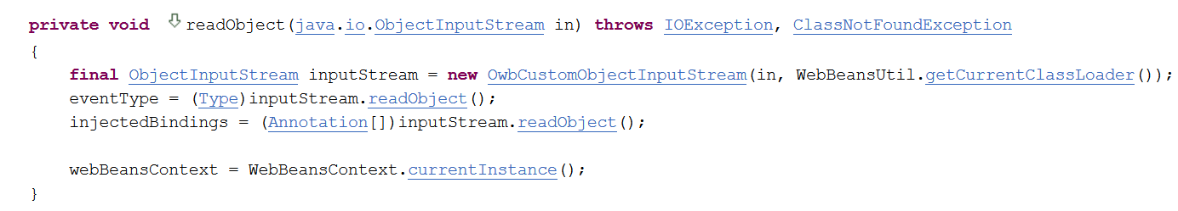
Block-lit Bypass Examples
org.apache.webbeans.inject.impl.InjectionPointImpl
org.apache.webbeans.inject.instance.InstanceImpl
org.apache.webbeans.event.EventImpl

Slide 33
Block-List Bypass and JEP 290
Process-wide filters will block deserialization even from the inner ObjectInputStream
System.setProperty("jdk.serialFilter",
"!org.owasp.ottawa.topten2017_A8.UnusedBeanWithSideEffect");
Filters applied to the outer ObjectInputStream can be bypassed
ObjectInputFilter.Config.setObjectInputFilter(myOis, myFilter);

Slide 34
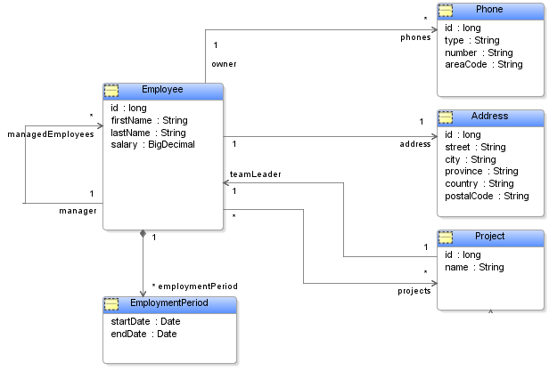
Why using Allow-lists is hard?
In real life, an entire Object Graph needs to be allowed
Each class needs to be audited to make sure there is no side effect
Notes:
Image Source: https://commons.wikimedia.org/wiki/File:Employee-model.PNG

Slide 35

Putting everything together
Deserializing untrusted input brings a serious risk
Look-ahead with Allow-list is the best mitigation
Hard to implement
Should only be used as a stop-gap solution
As a developer, Stop using serialization, it is not worth the risk
Use JSON instead
https://goo.gl/CjKZCU

Slide 36
Insecure Deserialization
Pierre Ernst, OWASP Ottawa
pierre.ernst@owasp.org
https://twitter.com/e_rnst
https://linkedin.com/in/pernst

